Slide 1


City of Storm Lake Housing Study Findings
Presented to: City of Storm Lake City Council
Presented by: Matt Mullins, Vice President
Maxfield Research & Consulting
April 21, 2025

Slide 2
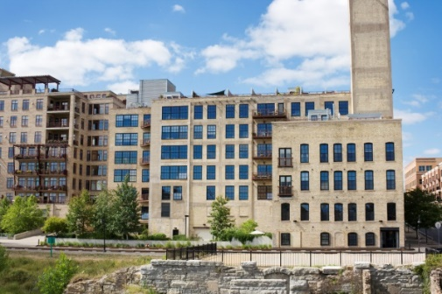
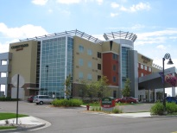
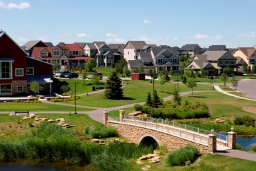
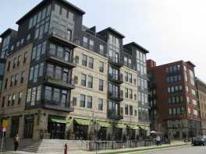
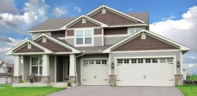

Maxfield Research & Consulting
We are a full-service real estate advisory company providing strategic value to our private and public sector clients’ real estate activities.
OVERVIEW
40 Years Experience
Diverse Client Base
Multi-Sector Capable
  Residential
  Commercial
  Public & Private Entities
Market Driven Strategies
Recommending Highest & Best Uses
Provide Actionable Plans

Slide 3
Project Scope
OBJECTIVE
Provide custom comprehensive housing study
APPROACH
Identify current & future housing needs for residents in Storm Lake and provide framework for meeting housing needs
PROJECT DELIVERABLES
Short and long-term housing needs
Recommendations guiding future housing development
Tools/policies to implement the plan
KEY DATES
Previous Housing Study: 2017
Data collection: Q3-Q4 2024
Draft: January 2025
Final Report: April 2025
Presentation: April 21, 2025

Slide 4
Demographics & Economics
Market Overview
Demand & Recommendations
Discussion

Slide 5
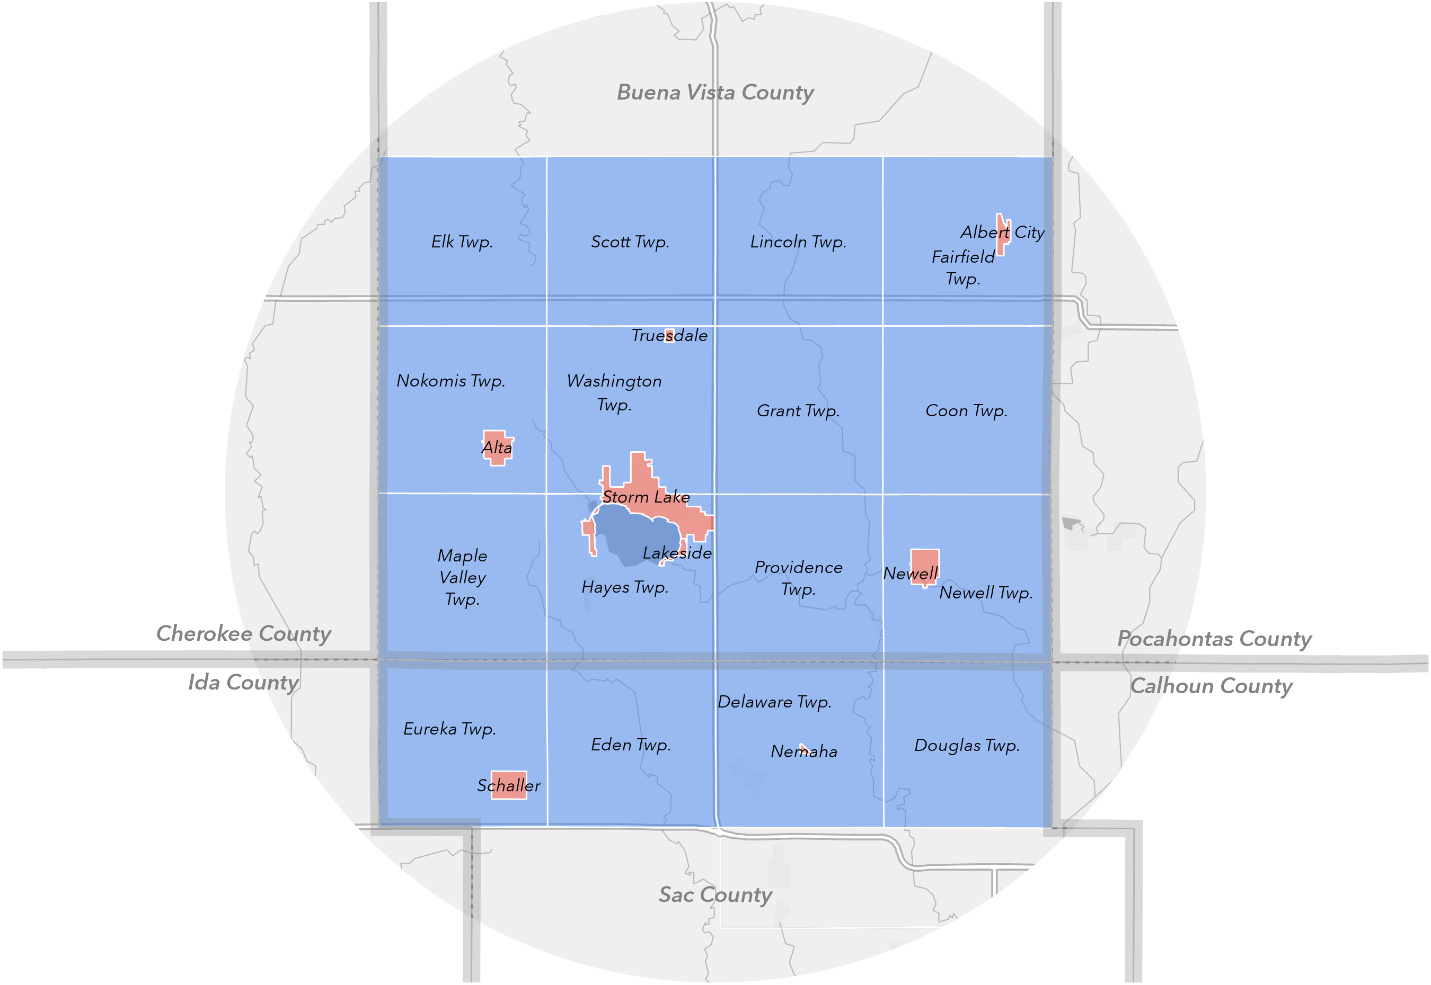
Storm Lake Primary Market Area (“PMA”)
11 Geographies
  8 Cities
  16 Townships
  2 counties: Buena Vista & Sac
Economic driver of PMA

Slide 6
6% growth rate last decade…forecast +9% this decade
Steady growth over next decade
Population diversity is growing in Storm Lake
65 to 84 population driving growth in the near-term

Slide 7
11% Household Growth this decade
70% of HH own homes in MA | 60% in Storm Lake
Younger demographic = more renters
  Under 25: 78% (Storm Lake)
  25 to 34: 54% (Storm Lake)

Slide 8
Larger Households are more likely to be Home-Owners…

Slide 9
Millennials: Highest Household Incomes
Lower-Income Earners are Majority Renters
Median Income by Tenure (Storm Lake):
  Owner: $73,774
  Renter: $48,178
Millennials & Gen X strongest household incomes…
Median Income: $60,741 (SL) vs. $68,115 (MA)

Slide 10
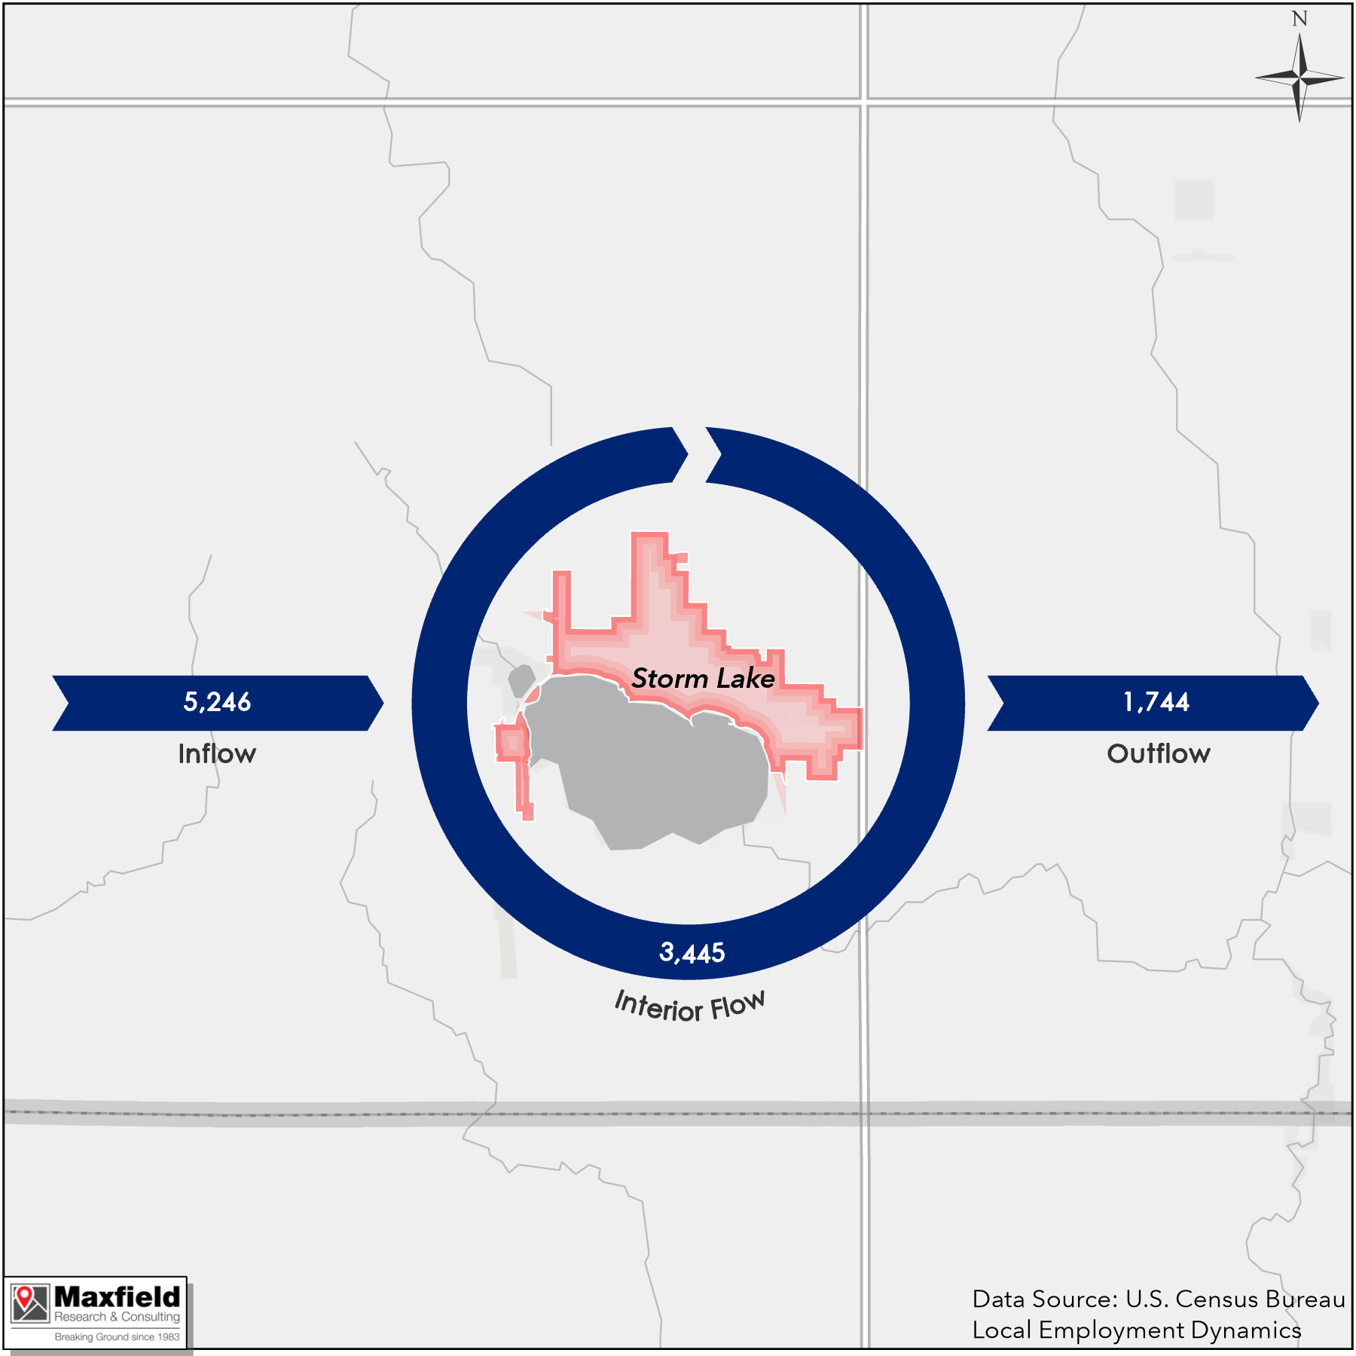
Storm Lake is a Major Job Importer
Storm Lake
  Inflow: 50%
  Interior Flow: 33%
  Outflow: 17%
Average weekly wage
  Buena Vista County: $989
    Highest wage: Management ($1,935)
  Iowa: $1,118
Employment by sector (Buena Vista County)
  Manufacturing: 3,645 | 34% of total
  Education: 1,386 | 13% of total
  Retail: 1,132 | 11% of total

Slide 11
Demographics & Economics
Market Overview
Demand & Recommendations
Discussion

Slide 12
80% of growth in Townhome & MF housing types…

Slide 13
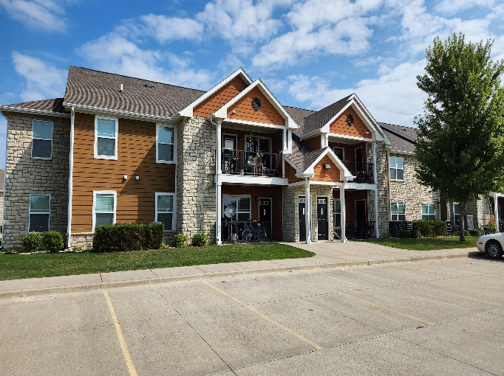
Sub 2% Vacancy Rate…Tight Rental Market!
The Reserves at Storm Lake

Slide 14
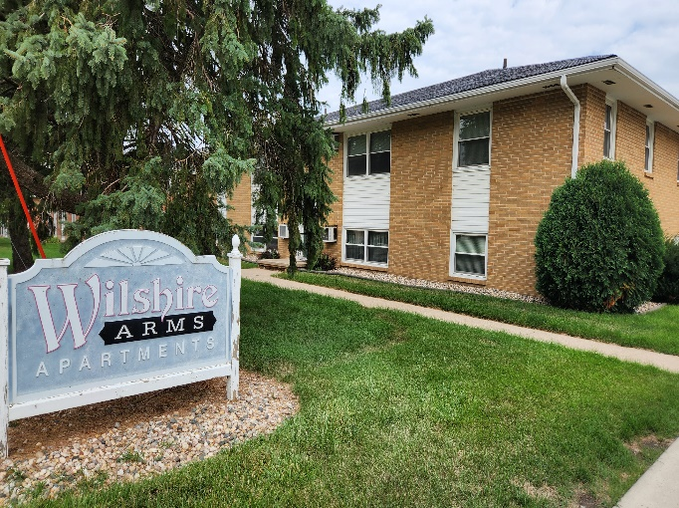
Majority of Units considered “Affordable”
Wilshire Arms Apts.
ALL Market Rate Apartments at 50% AMI or less

Slide 15
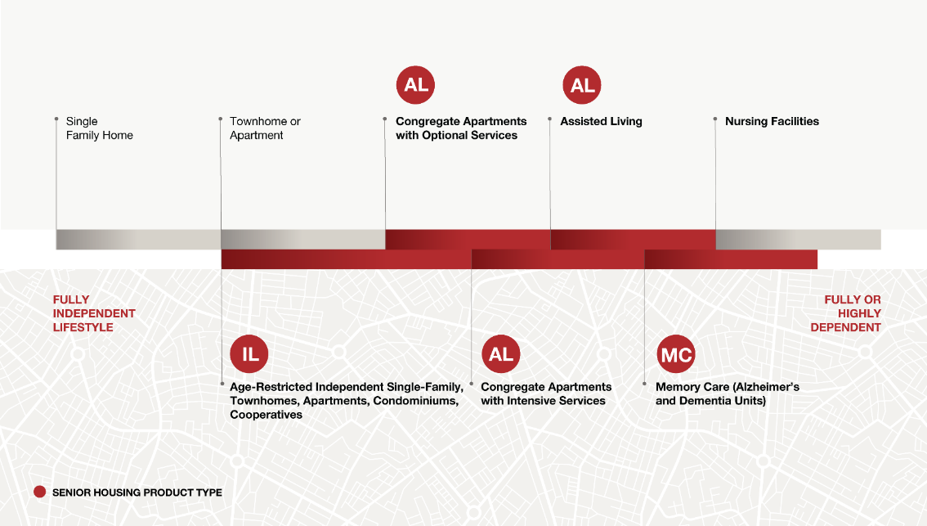
Senior Housing Continuum

Slide 16
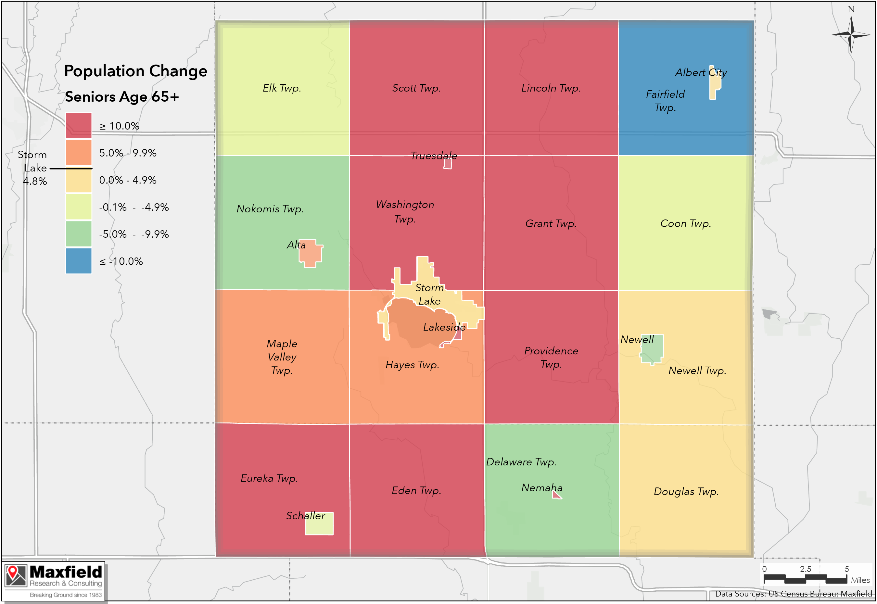
Senior Demographic if Growing Fastest…
Senior Population (65+) Percent Change (2010 – 2020)
Senior demo. fastest pop. growing in SL (2024 – 2035)
  65 to 74: 31%
  75 to 84: 66%
62% of 65+ households are homeowners | 76% in PMA

Slide 17
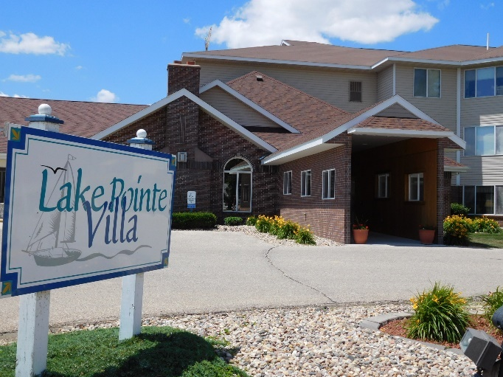
Bifurcation in Senior Vacancy Rates…
Methodist Manor – Lake Pointe Villa
Average Senior Housing Costs (Maxfield Survey)
  Independent Living: $2,264
  Assisted Living: $4,391
5% - 7% Vacancy = Market Equilibrium

Slide 18
Pandemic Housing Boom drove sales peak in 2021

Slide 19
Majority of SF Home Sales Last Year: $100-$199k (44%)

Slide 20
Interest Rates Elevated…still historically low

Slide 21
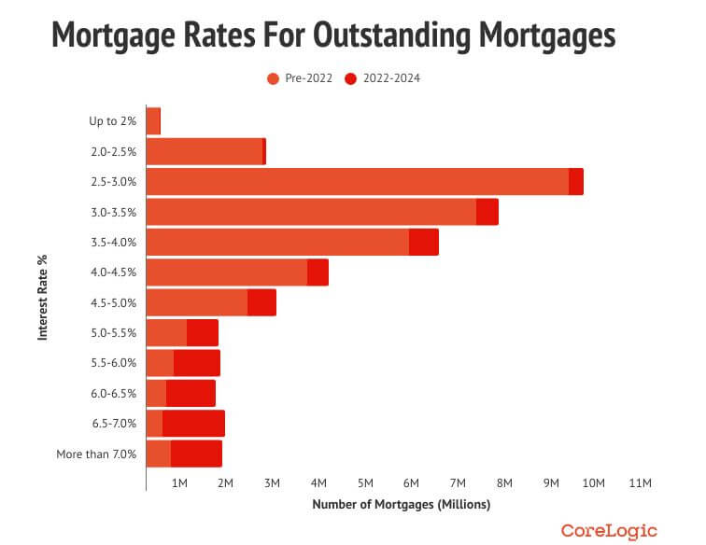
Mortgage Rate Lock In Effect…holding back supply
Nearly 73% of existing mortgages are under 5%!

Slide 22
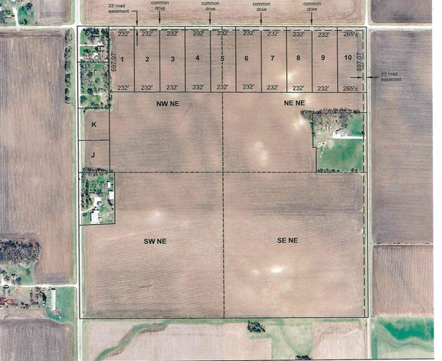
Lot Inventory…Excessively Low
Lot Inventory/Supply
Only SIX vacant lots across 3 subdivisions
Most vacant lots in Woodland Creek 1st Subdivision
Median lot size: 0.29 acres
Median land value: $10,315
Goal: 3- to- 5-year lot supply
Acreage lots outside city limits…

Slide 23
Demographics & Economics
Market Overview
Demand & Recommendations
Demand & Recommendations
Discussion

Slide 24
Demand Methodology
  Demand Driver Examples
  Demographics
  Economy & Job Growth
  Consumer Choice | Preferences
  Turnover/Mobility
  Supply (i.e. Existing Hsg. Stock)
  Replacement need (i.e. functionally /physically obsolete)
  Financing
Demand Overview
Household growth & tenure
Turnover
Income-qualified households
Demand by product | Preferences
Demand Assumptions/Methodology
Household growth adjusted for local factors (i.e. economy, building permits, etc.)
Senior demand estimates apply capture and penetration rates and are presented as “Point in Time” vs. Cumulative

Slide 25
Demand for 1,460+ Housing Units through 2035

Slide 26
Demand for 400+ more Housing Units since 2017 study

Slide 27
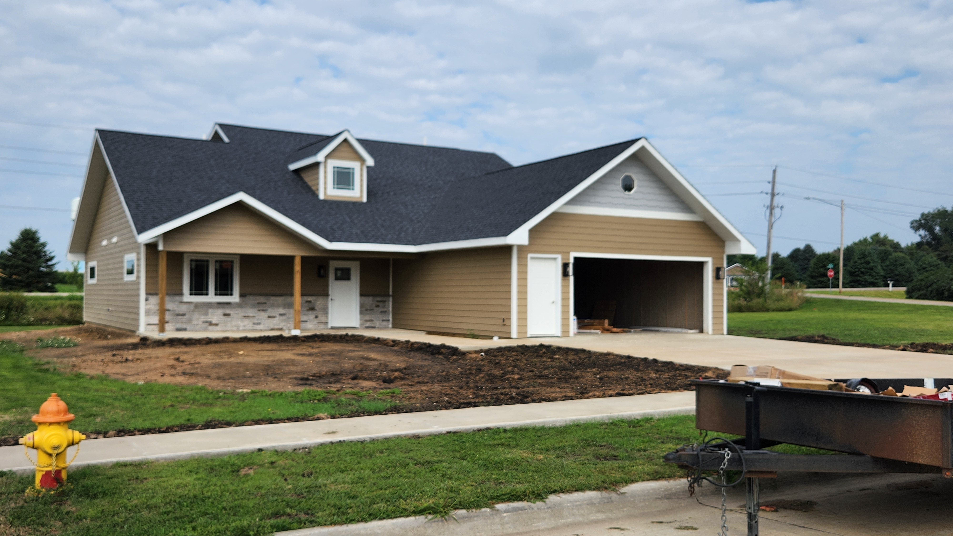
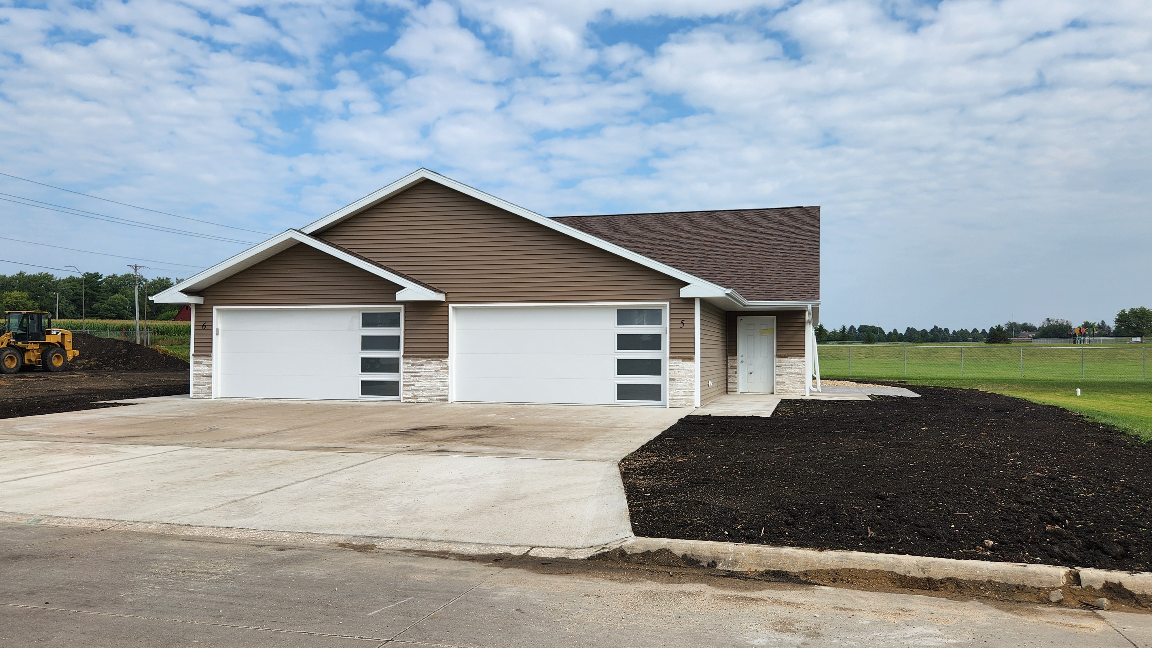
For-Sale Housing Recommendations to 2035
Single Family
Recommend 3 to 5-year lot supply
  Lot supply severely lacking…
  Need for all lot types
Demand for 300 SF homes
Demand across all price points
  However, entry-level difficult to build due to development cost
Multifamily
Demand for 142 units
Association-maintained product
  Popular with older adult and senior households
  More affordable price points compared to single-family
Potential housing types:
  Detached townhomes/villas
  Twin homes/townhomes
  Quad homes/rowhomes

Slide 28
Rental & Senior Housing Recommendations to 2035
General-Occupancy Rental Housing
Demand for 181 MR units
Recommend a variety of rental product/design types:
Vertical multifamily
Townhome-style
Single-family rentals
Demand for another 80+ affordable units
Senior Housing
Significant demand through this decade & beyond.. (i.e. baby boomers)
Demand grows as boomers age later this decade…
Demand by senior types:
  Active Adult:
    Market Rate Rental – 210 units
    Ownership (cooperative, etc.) – 113 units
  Independent Living – 163 units
  Assisted Living – 72 units
  Memory Care – 88 units

Slide 29
Key Takeaways…
Positive growth last decade, higher growth rates this decade | Declines in more rural townships
Aging of Older adults & Baby Boomer Generation| 75-84 growing fastest = alternative housing products
Family HHs declining | Persons living alone & roommates fastest growing HH type | 65% of HHs 1 & 2 person
Storm Lake is a Job Importer| Major increase in daytime population (i.e. goods & services, healthcare, etc.)
Low rental vacancy rates (1.9%) |Lack of newer rental product | Need for new market rate rental construction
Senior housing is bifurcated; yet vacancies rate at or below equilibrium for all service levels
For-sale market recently peaked, but slowing | lack of supply | Interest rates impacting sales/affordability
Vacant lot supply is dire| Lack of new construction| Need Lots & Association-maintained options
Inflation, interest rates and rising construction costs impact development opportunities in near-term
Rising insurance costs and mortgage rates impacting affordability….

Slide 30
Priorities
Lot Supply: Monitor lot-supply
  Detached single-family
  Need for association maintained and one-level living options
Promote rental housing production: all product types, incomes, etc.
Senior housing/Age-targeted housing….frees up existing housing stock
Promote private-public-partnerships (PPP) to stimulate housing markets
Implement housing programs/resources (i.e. 1st time buyers, fix-up funds, land banking, etc.)
Update housing action plan regularly
Promote affordability, recreation, open space, lifestyle, & hybrid work

Slide 31
Demographics & Economics
Market Overview
Demand & Recommendations
Discussion

Slide 32




Thank You!
MATT MULLINS
Maxfield Research & Consulting
612.281.6729
MMullins@MaxfieldResearch.com
MaxfieldResearch.com
https://www.linkedin.com/in/mattlmullins
http://www.linkedin.com/company/maxfield-research-inc
https://www.linkedin.com/in/mattlmullins

